Slide 1

Generative Models and Language Generation
汤斯亮（Siliang Tang）
siliang@zju.edu.cn

Slide 2
Generative Models
What I cannot create, I do not understand.
-- Richard Feynman
https://www.quora.com/What-did-Richard-Feynman-mean-when-he-said-What-I-cannot-create-I-do-not-understand

Slide 3
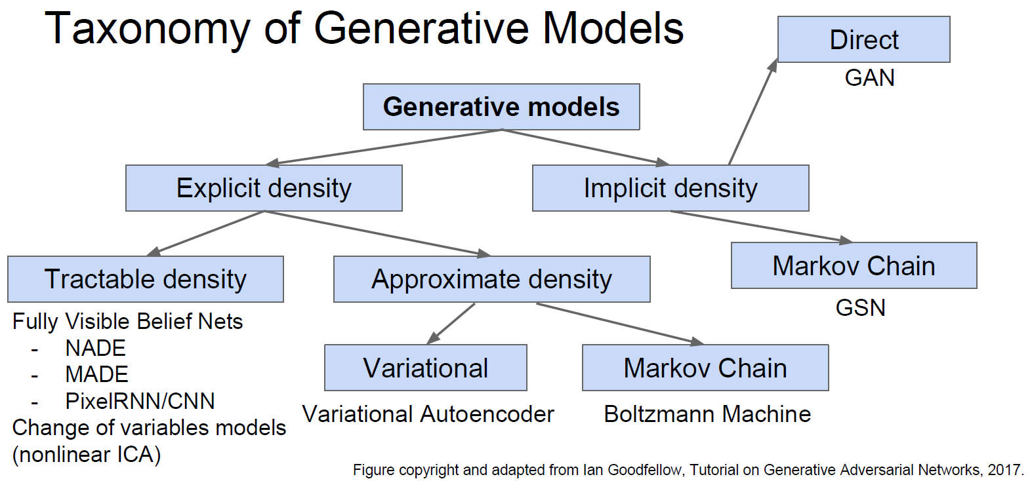
Generative Models

Slide 4
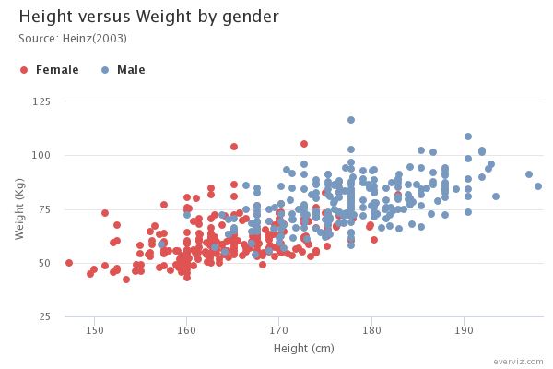
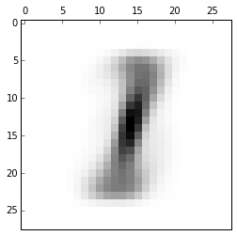
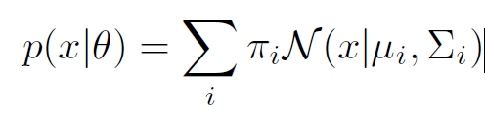
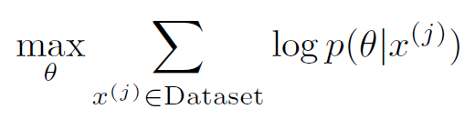
Gaussian Mixture Models
GMM
Good for low-dimensional data

Slide 5
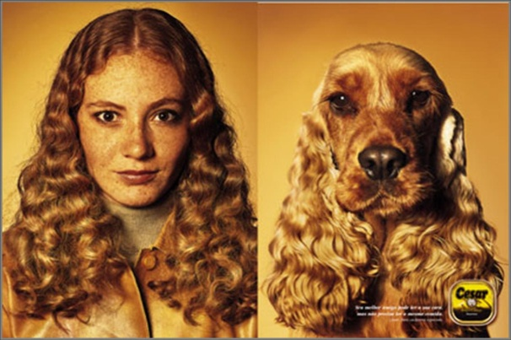
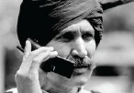

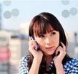
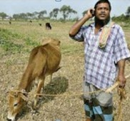
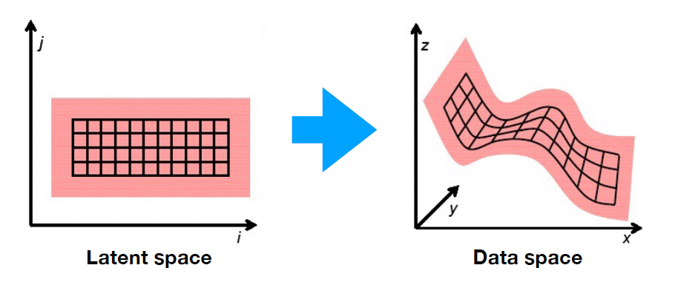
Manifold Assumption
特征相似，语义不同
特征不同，语义相似

Slide 6

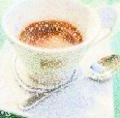
Auto-Encoder
As close as possible
NN
Encoder
NN
Decoder
code
= Generator
Randomly generate a vector as code
NN
Decoder
code
Image ?
= Generator

Slide 7




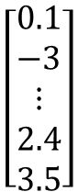
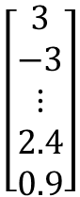
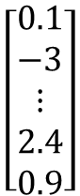
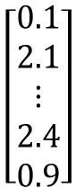
Auto-Encoder
a neural network (NN), or a function
Generator
image
vector
matrix
$$\left[\begin{aligned}0.1 \\ −3 \\ ⋮ \\ 2.4 \\ 0.9\end{aligned}\right]$$
$$\left[\begin{aligned}3 \\ −3 \\ ⋮ \\ 2.4 \\ 0.9\end{aligned}\right]$$
Generator
Generator
Longer hair
Each dimension of input vector represents some characteristics.
$$\left[\begin{aligned}0.1 \\ 2.1 \\ ⋮ \\ 2.4 \\ 0.9\end{aligned}\right]$$
$$\left[\begin{aligned}0.1 \\ −3 \\ ⋮ \\ 2.4 \\ 3.5\end{aligned}\right]$$
Generator
Generator
blue hair
Open mouth
http://mattya.github.io/chainer-DCGAN/

Slide 8
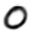
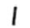
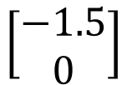
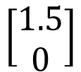
Auto-Encoder
2D
NN
Decoder
image
code
NN
Decoder
$$\left[\begin{aligned}1.5 \\ 0\end{aligned}\right]$$
-1.5
1.5
$$\left[\begin{aligned}−1.5 \\ 0\end{aligned}\right]$$
NN
Decoder

Slide 9
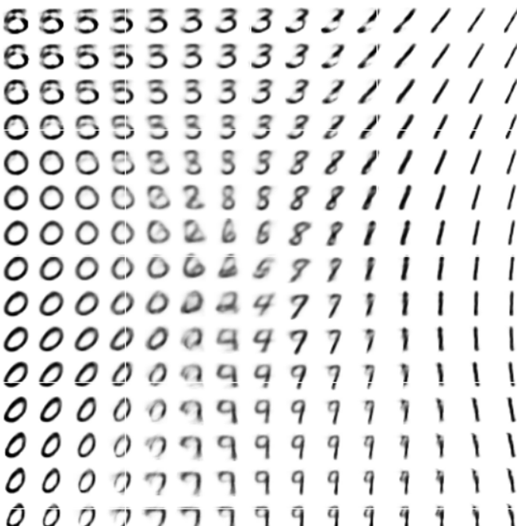
Auto-Encoder
-1.5
1.5

Slide 10
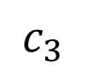
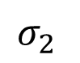
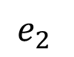
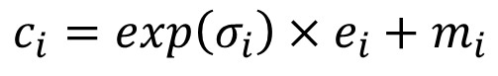
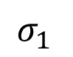
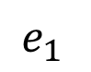
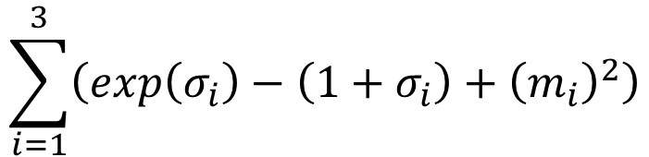
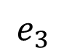
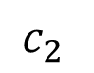
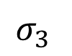
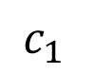
Variational AutoEncoders
Minimize reconstruction error
m₁
m₂
NN
Encoder
m₃
$$c_{1}$$
input
NN
Decoder
$$σ_{1}$$
exp
+
$$c_{2}$$
output
$$σ_{2}$$
$$c_{3}$$
$$σ_{3}$$
X
$$c_{i}=exp\left(σ_{i}\right)×e_{i}+m_{i}$$
$$e_{1}$$
From a normal distribution
$$e_{2}$$
Minimize
$$e_{3}$$
$$\sum_{i=1}^{3}{\left(exp\left(σ_{i}\right)−\left(1+σ_{i}\right)+{\left(m_{i}\right)}^{2}\right)}$$
[1]. Kingma and Welling, “Auto-encoding variational Bayes," ICLR 2014
[2]. Rezende, Mohamed, and Wierstra, “Stochastic back-propagation and variational inference in deep latent Gaussian models,” ICML 2014

Slide 11
Variational AutoEncoders
Samples from variational autoencoders
LFW dataset
ImageNet dataset
https://wiseodd.github.io/techblog/2016/12/10/variational-autoencoder/

Slide 12
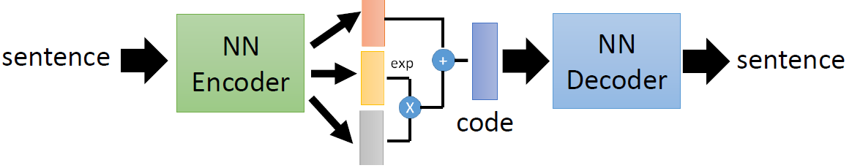
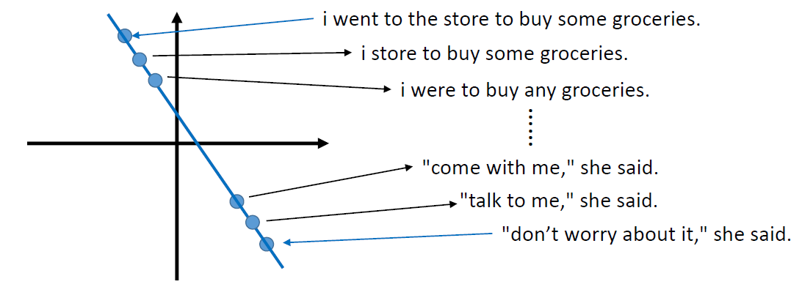
VAE: Writing Poetry
Code Space

Slide 13
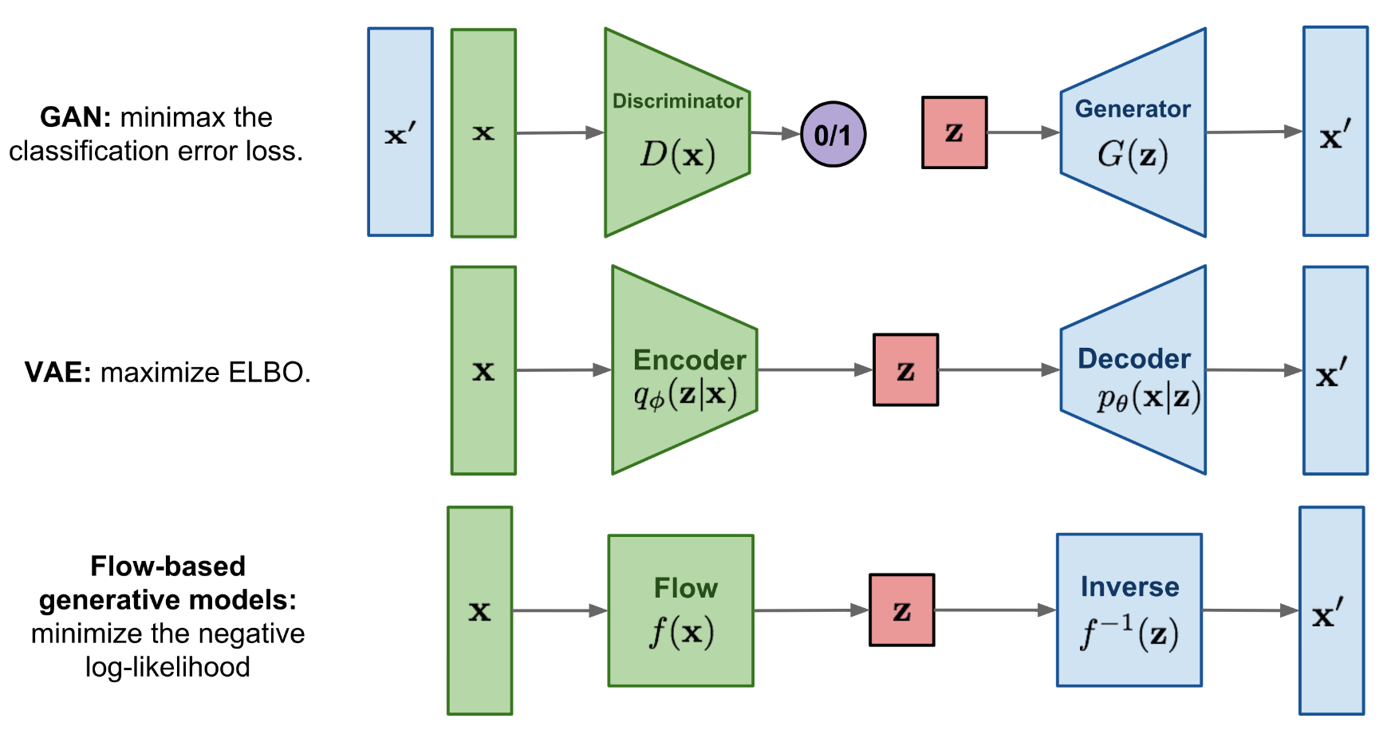
Flow-based Deep Generative Models
Flow-based generative models: A flow-based generative model is constructed by a sequence of invertible transformations. Unlike other two, the model explicitly learns the data distribution p(x) and therefore the loss function is simply the negative log-likelihood.

Slide 14
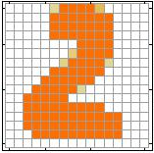
Variational AutoEncoders
Problems of VAE
Generated Image
Target
G
as close as possible

Slide 15
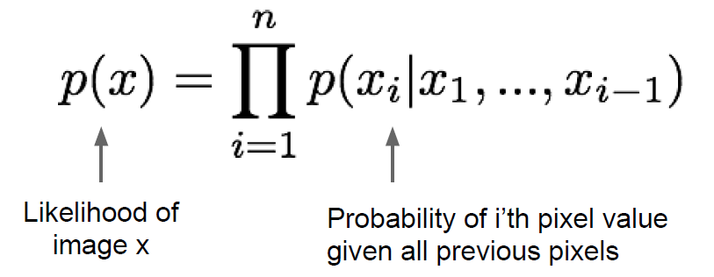
PixelRNN and PixelCNN
Fully visible belief network
Explicit density model
Use chain rule to decompose likelihood of an image x into product of 1-d distributions:
Then maximize likelihood of training data

Slide 16
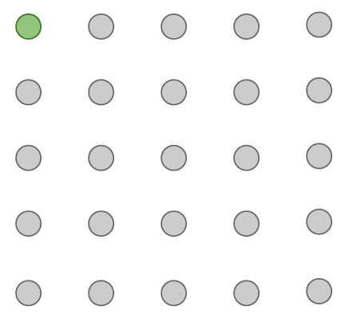
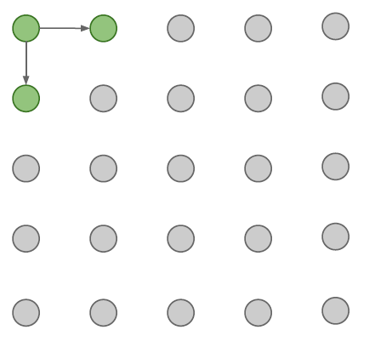
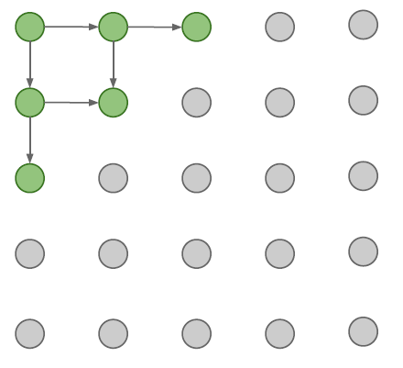
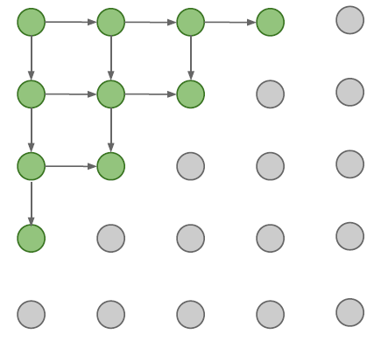
PixelRNN
Generate image pixels starting from corner
Dependency on previous pixels modeled using an RNN (LSTM)
Drawback: sequential generation is slow!

Slide 17
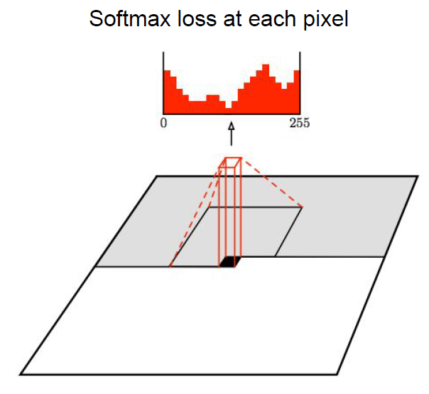
PixelCNN
Still generate image pixels starting from Corner
Dependency on previous pixels now modeled using a CNN over context region
Training: maximize likelihood of training images
Training is faster than PixelRNN (can parallelize convolutions since context region values known from training images)
Generation must still proceed sequentially => still slow

Slide 18
Natural Language Generation

Slide 19
Natural Language Generation (NLG)
Natural Language Generation refers to any setting in which we generate (i.e. write) new text.
NLG is a subcomponent of:
Machine Translation
(Abstractive) Summarization
Dialogue (chit-chat and task-based)
Creative writing: storytelling, poetry-generation
Freeform Question Answering (i.e. answer is generated, not extracted from text or knowledge base)
Image captioning
…

Slide 20
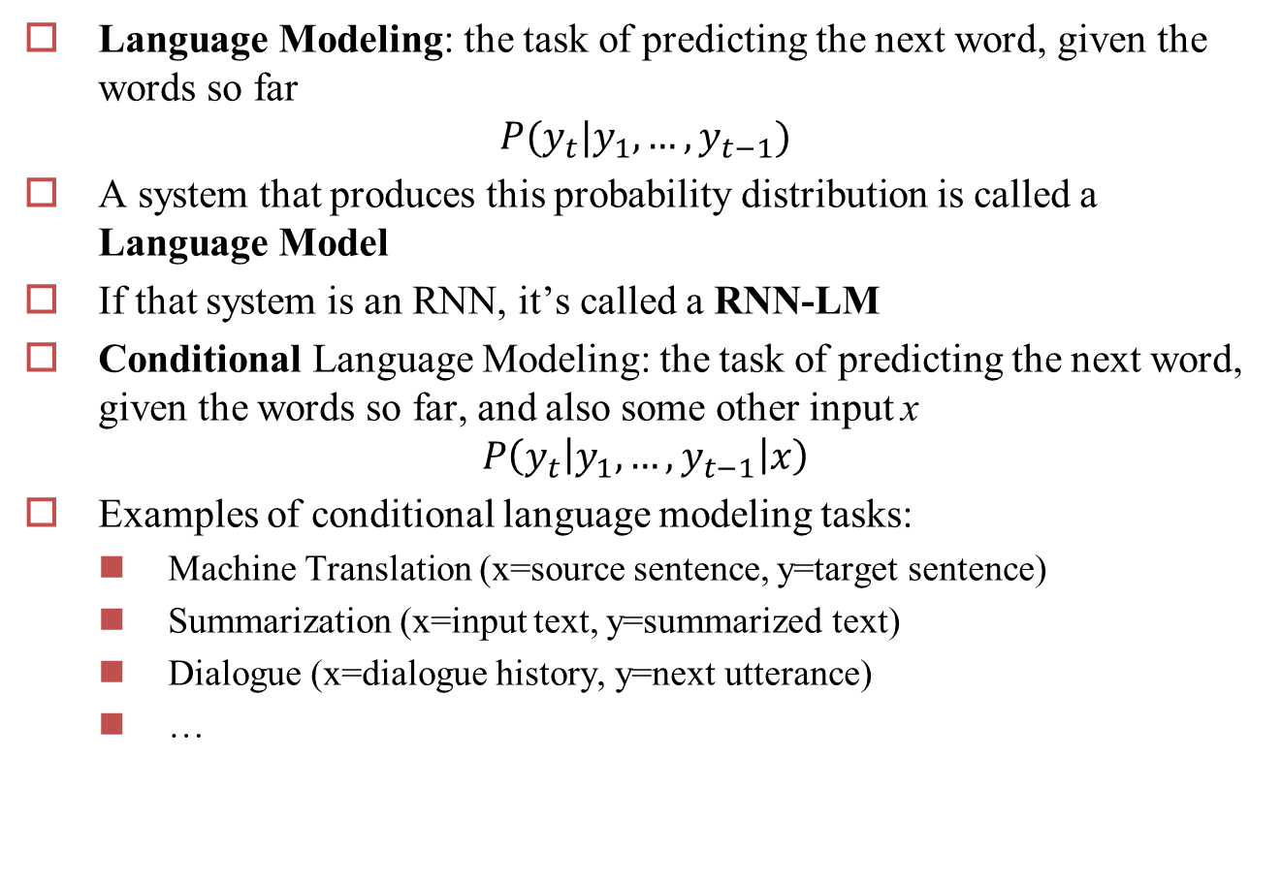
RNN-LM
Language Modeling: the task of predicting the next word, given the words so far
$$P(y_{t}|y_{1},…, y_{t−1})$$
A system that produces this probability distribution is called a Language Model
If that system is an RNN, it’s called a RNN-LM
Conditional Language Modeling: the task of predicting the next word, given the words so far, and also some other input x
$$P\left(y_{t}\left|y_{1},…, y_{t−1}\right|x\right)$$
Examples of conditional language modeling tasks:
Machine Translation (x=source sentence, y=target sentence)
Summarization (x=input text, y=summarized text)
Dialogue (x=dialogue history, y=next utterance)
…

Slide 21


(One Type of) Language Model
<s> I hate this movie
LSTM
LSTM
LSTM
LSTM
LSTM
predict
predict
predict
predict predict
movie </s>
I
hate
this
(Mikolov et al. 2011)

Slide 22


(One Type of) Conditional Language Model
kono eiga ga kirai
</s>
Encoder
LSTM
LSTM
LSTM
LSTM
LSTM
I
hate
this
movie
LSTM
LSTM
LSTM
LSTM
argmax argmax
I hate
argmax
argmax
argmax
</s>
this
movie
Decoder
(Sutskever et al. 2014)

Slide 23
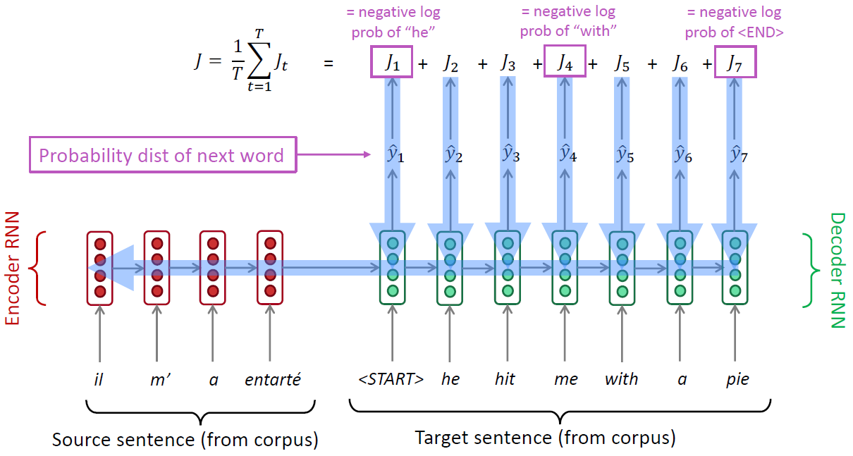
Training a (conditional) RNN-LM
example: Neural Machine Translation
During training, we feed the gold (aka reference) target sentence into the decoder, regardless of what the decoder predicts. This training method is called Teacher Forcing.

Slide 24
How to Pass Hidden State?
Initialize decoder w/ encoder (Sutskever et al. 2014)
encoder decoder
Transform (can be different dimensions)
encoder transform decoder
•
•
Input at every time step (Kalchbrenner & Blunsom 2013)
decoder decoder decoder
encoder

Slide 25
The Generation Problem
We have a model of P(Y|X), how do we use it to generate a sentence?
Two methods:
Sampling: Try to generate a random sentence according to the probability distribution.
Argmax: Try to generate the sentence with the highest probability.
Ancestral Sampling
Randomly generate words one-by-one.
An exact method for sampling from P(X), no further work needed.
Greedy Search
One by one, pick the single highest-probability word
Not exact, real problems:
Will often generate the “easy” words first
Will prefer multiple common words to one rare word
while yj-1 != “</s>”:
yj ~ P(yj | X, y1, …, yj-1)

Slide 26
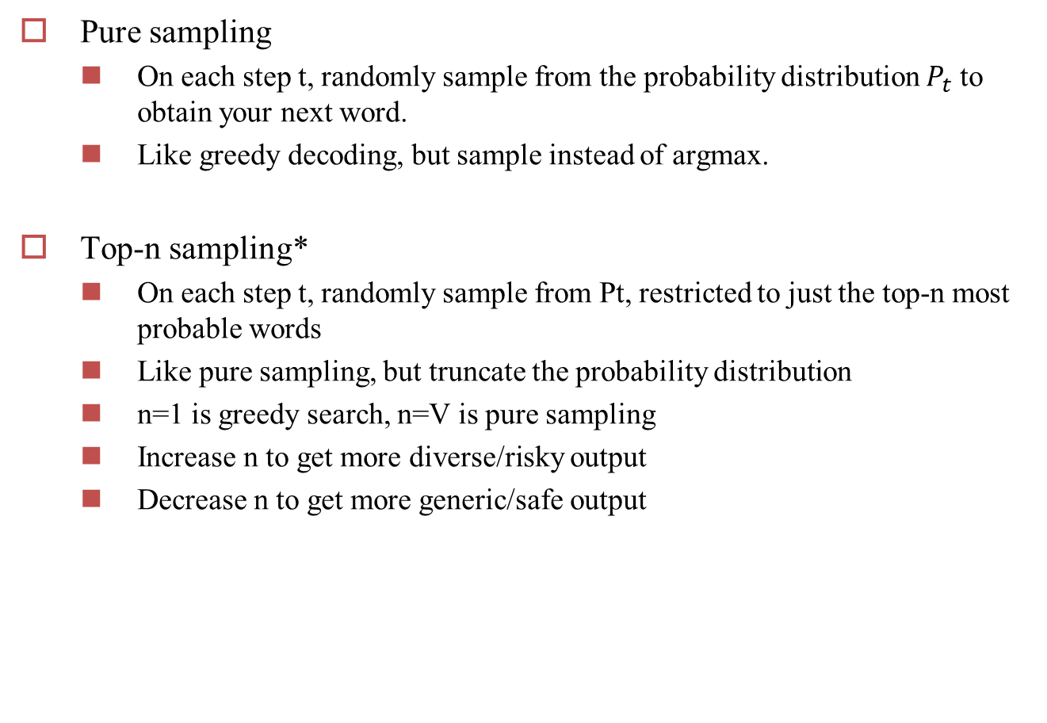
Sampling-based decoding
Pure sampling
On each step t, randomly sample from the probability distribution $P_{t}$ to obtain your next word.
Like greedy decoding, but sample instead of argmax.
Top-n sampling*
On each step t, randomly sample from Pt, restricted to just the top-n most probable words
Like pure sampling, but truncate the probability distribution
n=1 is greedy search, n=V is pure sampling
Increase n to get more diverse/risky output
Decrease n to get more generic/safe output

Slide 27
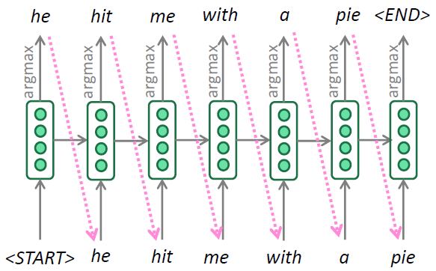
Greedy decoding
A simple algorithm
On each step, take the most probable word (i.e. argmax)
Use that as the next word, and feed it as input on the next step
Keep going until you produce <END> (or reach some max length)
Due to lack of backtracking, output can be poor

Slide 28
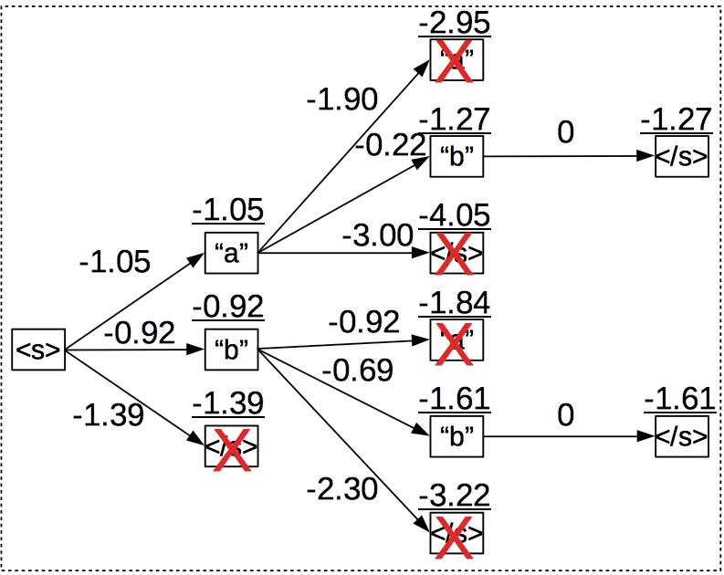
Beam search decoding(1)
A search algorithm which aims to find a high-probability sequence (not necessarily the optimal sequence, though) by tracking multiple possible sequences at once.
Core idea: On each step of decoder, keep track of the k most probable partial sequences (which we call hypotheses)
k is the beam size
After you reach some stopping criterion, choose the sequence with the highest probability (factoring in some adjustment for length)

Slide 29
Changing beam size k?(1)
Small k has similar problems to greedy decoding (k=1)
Ungrammatical, unnatural, nonsensical, incorrect
Larger k means you consider more hypotheses
Increasing k reduces some of the problems above
Larger k is more computationally expensive
But increasing k can introduce other problems:
For NMT, increasing k too much decreases BLEU score (Tu et al, Koehnet al). This is primarily because large-k beam search produces too short translations (even with score normalization!)
In open-ended tasks like chit-chat dialogue, large k can make output more generic (see next slide)

Slide 30
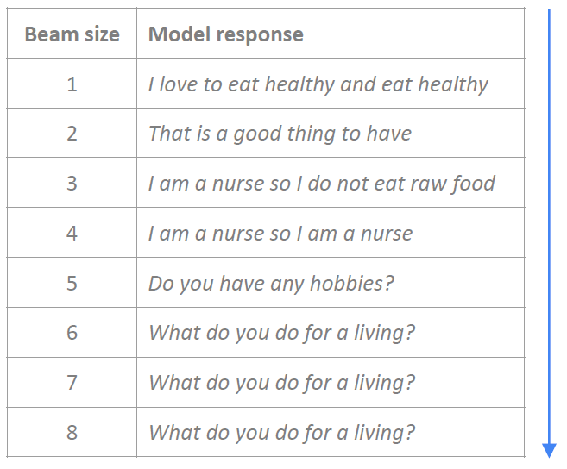
Changing beam size k?(2)

Slide 31
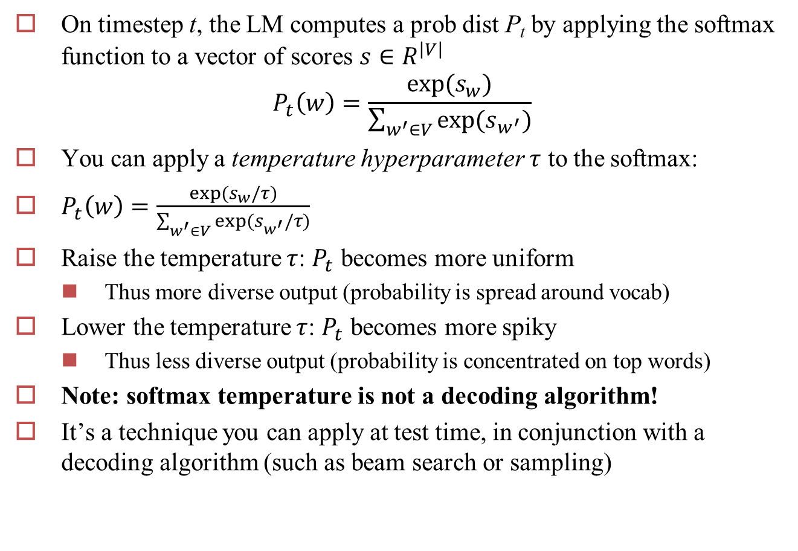
Softmax temperature
On timestep t, the LM computes a prob dist P_{t} by applying the softmax function to a vector of scores $s∈R^{\left|V\right|}$
$$P_{t}\left(w\right)=\frac{exp⁡(s_{w})}{\sum_{w^{′}∈V}{exp⁡(s_{w^{′}})}}$$
You can apply a temperature hyperparameter $τ$ to the softmax:
$P_{t}\left(w\right)=\frac{exp⁡(s_{w}/τ)}{\sum_{w^{′}∈V}{exp⁡(s_{w^{′}}/τ)}}$
Raise the temperature $τ$: $P_{t}$ becomes more uniform
Thus more diverse output (probability is spread around vocab)
Lower the temperature $τ$: $P_{t}$ becomes more spiky
Thus less diverse output (probability is concentrated on top words)
Note: softmax temperature is not a decoding algorithm!
It’s a technique you can apply at test time, in conjunction with a decoding algorithm (such as beam search or sampling)

Slide 32
Decoding algorithms: in summary
Greedy decoding is a simple method; gives low quality output
Beam search (especially with high beam size) searches for high probability output
Delivers better quality than greedy, but if beam size is too high, can return high-probability but unsuitable output (e.g. generic, short)
Sampling methods are a way to get more diversity and randomness
Good for open-ended / creative generation (poetry, stories)
Top-n sampling allows you to control diversity
Softmax temperature is another way to control diversity
It’s not a decoding algorithm! It's a technique that can be applied alongside any decoding algorithm.

Slide 33
Ensembling
Combine predictions from multiple models
<s> <s>
LSTM1
LSTM2
predict1
predict2
I
Why?
Multiple models make somewhat uncorrelated errors
Models tend to be more uncertain when they are about to make errors
Smooths over idiosyncrasies of the model

Slide 34
Evaluation

Slide 35
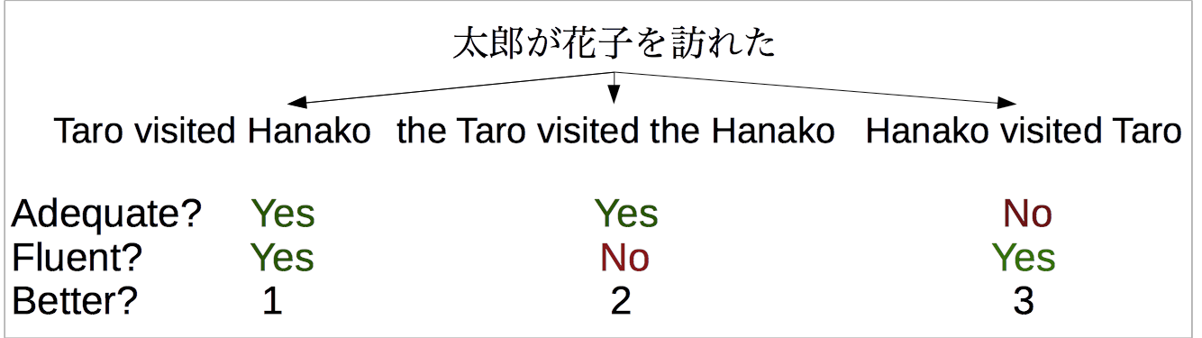
Human Evaluation
Ask a human to do evaluation
•
Final goal, but slow, expensive, and sometimes inconsistent

Slide 36
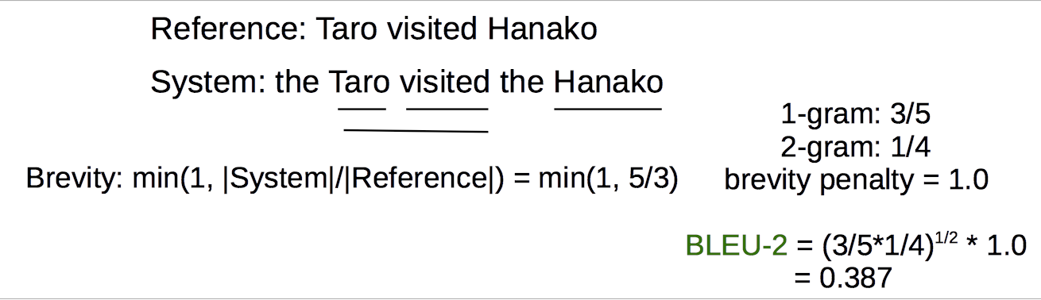
BLEU
Works by comparing n-gram overlap w/ reference
•
Pros: Easy to use, good for measuring system improvement
•
Cons: Often doesn’t match human eval, bad for comparing very different systems

Slide 37
METEOR
Like BLEU in overall principle, with many other tricks: consider paraphrases, reordering, and function word/content word difference
•
Pros: Generally significantly better than BLEU, esp. for high-resource languages
•
Cons: Requires extra resources for new languages (although these can be made automatically), and more complicated

Slide 38
Perplexity
Calculate the perplexity of the words in the held-out set without doing generation
•
Pros: Naturally solves multiple-reference problem!
•
Cons: Doesn’t consider decoding or actually generating output.
•
May be reasonable for problems with lots of ambiguity.

Slide 39
Evaluating Unconditioned Generation
How do we evaluate unconditioned generation models?
Not clear! We could do human evaluation.
But a model that memorizes the corpus will be too good.
Perhaps held-out perplexity is as good as we can do?
Perhaps we should use conditioned generation.

Slide 40
Any Questions?

